Slide 1
Inheritance Concept C++
Inheritance is the concept in object oriented programming language, which through child class can access data member and member function of parent class.
Feature of Inheritance:
1. Code Reusability .
2. Method Overriding in Single L. Inheritance.
3.Tightly Coupled (Disadvantage)
Type of Inheritance
1. Single label inheritance.
2. Multi Label inheritance
3. Multiple inheritance
4. hierarchy label inheritance..etc.
5. Hybrid Inheritance.
Notes:
The University of Adelaide, School of Computer Science
Chapter 2 — Instructions: Language of the Computer

Slide 2
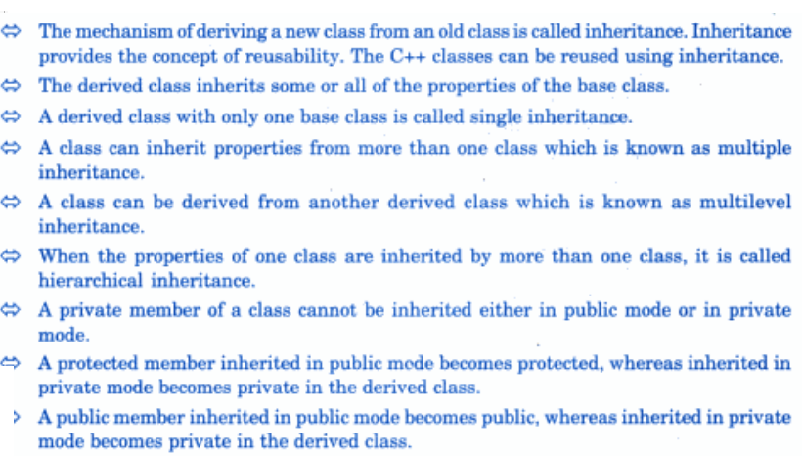
Notes:
The University of Adelaide, School of Computer Science
Chapter 2 — Instructions: Language of the Computer

Slide 3
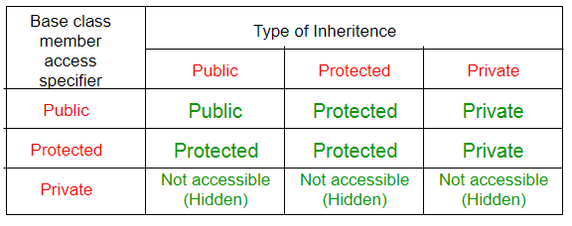
Notes:
The University of Adelaide, School of Computer Science
Chapter 2 — Instructions: Language of the Computer

Slide 4
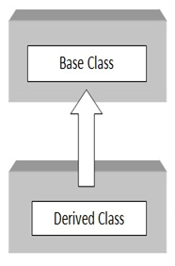
Ex:1: Single Label Inheritance.
In single label inheritance, child class inherit the data member and property of parent class.
Syntax :
class abc
{
public:
data member;
member function( ) { }
};
Class xyz:public abc
{
public:
data member;
member function() { }
};
int main()
{
xyz obj;
obj.P_function();
obj.C_function();
return 0;
}
class A
{
public:
int a,b,c;
void getdata()
{
cout<<"Enter two number=";
cin>>a>>b;
c=a+b;
cout<<"Sum of two number=";
}
};
class B:public A
{
public:
void product()
{
cout<<"Enter two number=";
cin>>a>>b;
c=a*b;
cout<<"Multiplication="<<c;
}
}
void main()
{
B obj;
obj.getdata();
obj.product();
}
Notes:
The University of Adelaide, School of Computer Science
Chapter 2 — Instructions: Language of the Computer

Slide 5
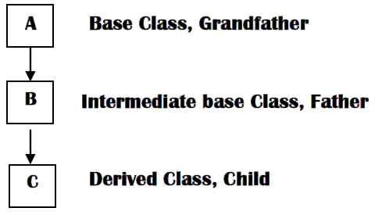
Ex:1: Multi Label Inheritance.
A Class which contain only one base class and multiple derived class is called multi label inheritance.
Syntax :
class A
{
public:
data member;
member function( ) { }
};
class B:public A
{
public:
data member;
member function() { }
};
class C: public A
{
public:
data member;
member function() { }
}
int main()
{
A obj;
obj.P_function();
B obj1;
obj1.P_function();
C obj2;
obj2.P_function();
return 0;
}
Notes:
The University of Adelaide, School of Computer Science
Chapter 2 — Instructions: Language of the Computer

Slide 6
Ex:1: Multi Label Inheritance.
class A
{
public:
int a,b,c;
void getdata()
{
cout<<"Enter two number=";
cin>>a>>b;
c=a+b;
cout<<"Sum of two number=";
}
}
class B:public A
{
public:
void product()
{
cout<<"Enter two number=";
cin>>a>>b;
c=a*b;
cout<<"Multiplication ="<<c;
}
}
class c:public A
{
public:
void mul()
{
cout<<"Enter two number=";
cin>>a>>b;
c=a*b;
cout<<"Multiplication ="<<c;
}
}
int main()
{
B obj;
c obj2;
obj.getdata();
obj.product();
obj2.mul();
}
Notes:
The University of Adelaide, School of Computer Science
Chapter 2 — Instructions: Language of the Computer

Slide 7
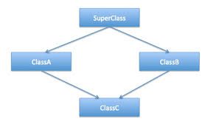
Ex:3: Multiple Inheritance :
A class which contain more base class and only one derived class is called multiple inheritance
Syntax :
class abc
{
};
class xyz
{
};
class3:public abc,xyz
{
};
Notes:
The University of Adelaide, School of Computer Science
Chapter 2 — Instructions: Language of the Computer

Slide 8
Ex:3: Multiple Inheritance :
#include<iostream>
using namespace std;
class M
{
protected:
int a;
public:
void getData(int );
};
class N
{
protected:
int b;
public:
void getData1(int );
};
class p:public M,N
{
protected:
void displany();
};
void M::getData(int x)
{
a=x;
}
void N::getData1(int y)
{
b=y;
}
void p::display()
{
cout<<"Value of x="<<a;
cout<<"\n Value of y="<<b;
cout<<"\n Value of x*y="<<(a*b);
}
int main()
{
p obj;
obj.getData(10);
obj.getData1(20);
obj.display();
return 0;
}
Notes:
The University of Adelaide, School of Computer Science
Chapter 2 — Instructions: Language of the Computer

Slide 9
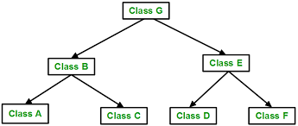
Ex:4: Hierarchical Inheritance
A class which contain only one base and multiple derive class but each derive class can access base class is called hierarchical inheritance.
class abc
{
}
class xyz:public abc
{
}
class derive :public abc
{
}
Notes:
The University of Adelaide, School of Computer Science
Chapter 2 — Instructions: Language of the Computer

Slide 10
Ex:4: Hierarchical Inheritance
#include <iostream>
using namespace std;
class A //single base class
{
public:
int x, y;
void getdata()
{
cout << "\nEnter value of x and y:\n";
cin >> x >> y;
}
};
class B : public A
{
public:
void product()
{
cout << "\nProduct= " << x * y;
}
};
class C : public A //C is also derived from
class base
{
public:
void sum()
{
cout << "\nSum= " << x + y;
}
};
int main()
{
B obj1; //object of derived class B
C obj2; //object of derived class C
obj1.getdata();
obj1.product();
obj2.getdata();
obj2.sum();
return 0;
} //end of program
Notes:
The University of Adelaide, School of Computer Science
Chapter 2 — Instructions: Language of the Computer

Slide 11
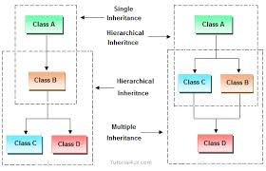
Program of Hybrid Inheritance
Ex:5: Hybrid Inheritance
It is the combination of more than one type of inheritance is called hybrid inheritance.
class A
{
member of base class
}
class B: virtual public/private/protected A
{
member of derived class
}
class C: virtual public/private/protected A
{
}
class D:public A
{
}
Class B,C : A
Class D:C,B
Notes:
The University of Adelaide, School of Computer Science
Chapter 2 — Instructions: Language of the Computer

Slide 12
Ex:5: Hybrid Inheritance
#include<iostream>
using namespace std;
class student
{
protected:
int roll_no;
public:
void getData(int x)
{
roll_no=x;
}
void putData()
{
cout<<"\n Student Roll_No is="<<roll_no;
}
};
class test:public student
{
protected:
float num1, num2;
public:
void getMarks(float x,float y)
{
num1=x;
num2=y;
}
void ShowData()
{
cout<<"\n Marks obtaned by Student=";
cout<<"\n Marks in math="<<num1;
cout<<"\n Marks in science="<<num2;
}
};
Notes:
The University of Adelaide, School of Computer Science
Chapter 2 — Instructions: Language of the Computer

Slide 13
Ex:5: Hybrid Inheritance
class sports
{
protected:
float score;
public:
void getScore(float s)
{
score=s;
}
void putScore()
{
cout<<"\n Sports Score="<<score;
}
};
class result:public test,public sports
{
float total;
public:
void display();
};
void result::display()
{
total=num1+num2+score;
putData();
ShowData();
putScore();
cout<<"\nTotal Score of student="<<total;
}
int main()
{
result obj;
obj.getData(101);
obj.getMarks(70,80);
obj.getScore(80);
obj.display();
return 0;
}
Notes:
The University of Adelaide, School of Computer Science
Chapter 2 — Instructions: Language of the Computer

Slide 14
Ex:1: Virtual Base Class :
The duplication of inherited members
Due to multiple path can be avoided by making the common base class as virtual base class while declaring the direct or intermediate base classes as shown below.
Class A
{ body;
}
Class B1 : public virtual A
{
}
Class B2: pubic virtual A
{
}
Class C: public B1, public B2
{
};
When class is made a virtual base class , C++ take necessary take care to see that only one copy of that class is inherited, regardless of how many inheritance path exist between the virtual base class and a derived class.
Notes:
The University of Adelaide, School of Computer Science
Chapter 2 — Instructions: Language of the Computer

Slide 15
Ex:5: Virtual Base Class.
#include<iostream>
using namespace std;
class student
{
protected:
int roll_no;
public:
void getData(int x)
{
roll_no=x;
}
void putData()
{
cout<<"\n Student Roll_No is="<<roll_no;
}
};
class test:public virtual student
{
protected:
float num1, num2;
public:
void getMarks(float x,float y)
{
num1=x;
num2=y;
}
void ShowData()
{
cout<<"\n Marks obtaned by Student=";
cout<<"\n Marks in math="<<num1;
cout<<"\n Marks in science="<<num2;
}
};
Notes:
The University of Adelaide, School of Computer Science
Chapter 2 — Instructions: Language of the Computer

Slide 16
Ex:5: Virtual Base Class
class sports: public virtual student
{
protected:
float score;
public:
void getScore(float s)
{
score=s;
}
void putScore()
{
cout<<"\n Sports Score="<<score;
}
};
class result:public test,public sports
{
float total;
public:
void display();
};
void result::display()
{
total=num1+num2+score;
putData();
ShowData();
putScore();
cout<<"\nTotal Score of student="<<total;
}
int main()
{
result obj;
obj.getData(101);
obj.getMarks(70,80);
obj.getScore(80);
obj.display();
return 0;
}
Notes:
The University of Adelaide, School of Computer Science
Chapter 2 — Instructions: Language of the Computer

